Slide 1
Mix Panel
Presented By
Tina Shrestha

Slide 2
Content
Introduction
Benefits over Google Analytics
Set Up for Mix Panel
Snapshots

Slide 3
Introduction to Mix Panel
Analytics platform for in-depth user behaviour analysis.
Focus on events, not just page views.

Slide 4
Benefits over Google Analytics
User Focus:
Google Analytics: Website/app traffic, demographics, acquisition sources.
Mix panel: Emphasis on user behaviour analytics within applications.
Event Tracking:
Google Analytics: Tracks standard web metrics; supports event tracking.
Mix panel: Specializes in detailed event tracking for user interactions.

Slide 5
Benefits over Google Analytics
Real-time Analytics:
Google Analytics: Provides real-time data with slight delays.
Mix panel: Offers real-time analytics for instant user interaction insights.
Retention Analytics:
Google Analytics: Some retention data.
Mix panel: Advanced retention analysis for app engagement over time.

Slide 6
Set Up For Mix Panel
Sign up for an Account: Go to the Mixpanel website and sign up for an account.
Create a Project: Once you're logged in, create a new project. This is typically where you'll track data for a specific app or website.

Slide 7
Set Up For Mix Panel
Install the Mixpanel Library: Depending on your platform (web, iOS, Android), you'll need to install the Mixpanel library. For web, it usually involves adding a snippet of JavaScript to your site. For mobile apps, you'll integrate the Mixpanel SDK.
<!-- Google Tag Manager --><script>(function(w,d,s,l,i){w[l]=w[l]||[];w[l].push({'gtm.start':new Date().getTime(),event:'gtm.js'});var f=d.getElementsByTagName(s)[0],j=d.createElement(s),dl=l!='dataLayer'?'&l='+l:'';j.async=true;j.src='https://www.googletagmanager.com/gtm.js?id='+i+dl;f.parentNode.insertBefore(j,f);})(window,document,'script','dataLayer','GTM-WHS6H2ZM');</script><!-- End Google Tag Manager -->
<!-- Google Tag Manager (noscript) --><noscript><iframe src="https://www.googletagmanager.com/ns.html?id=GTM-WHS6H2ZM"height="0" width="0" style="display:none;visibility:hidden"></iframe></noscript><!-- End Google Tag Manager (noscript) -->

Slide 8
Set Up For Mix Panel
Initialize Mixpanel: In your code, initialize Mixpanel with your project token. This token is unique to your project and is used to send data to the correct project.
Start Tracking Events: Identify the key events you want to track, like button clicks, sign-ups, or purchases. Use the Mixpanel API to track these events in your code

Slide 9
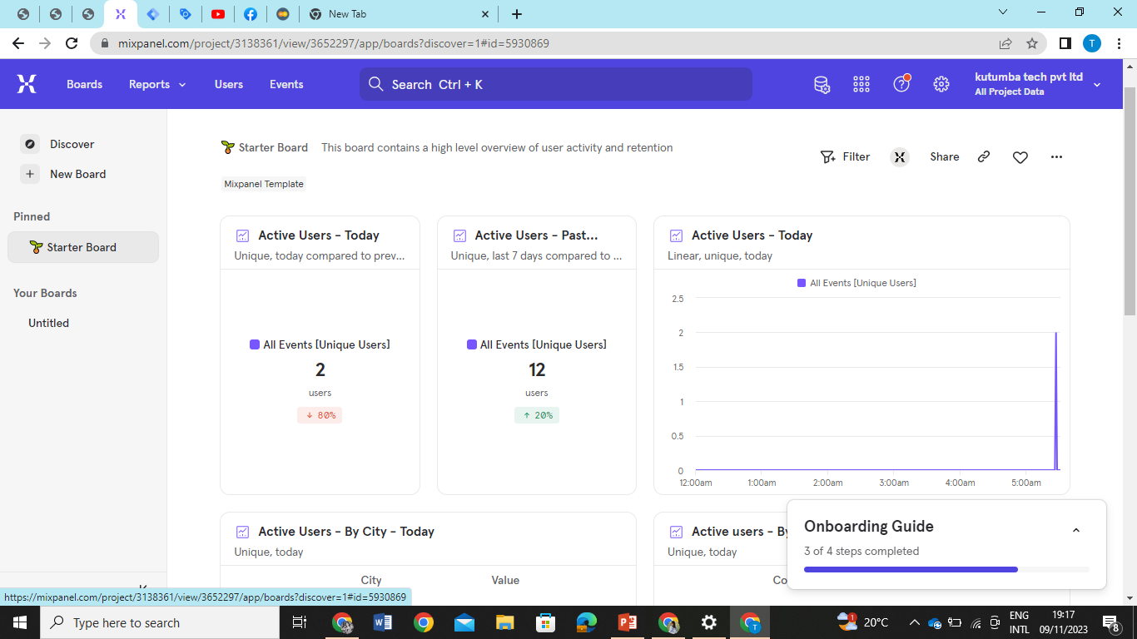

Slide 10
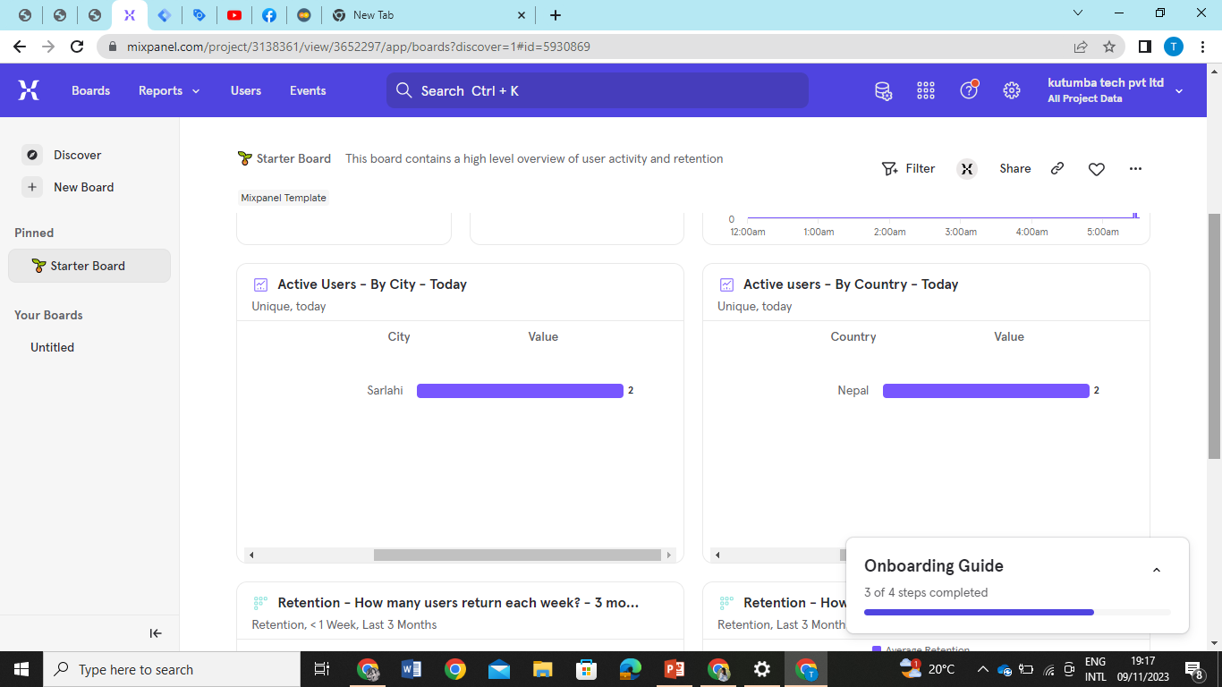

Slide 11
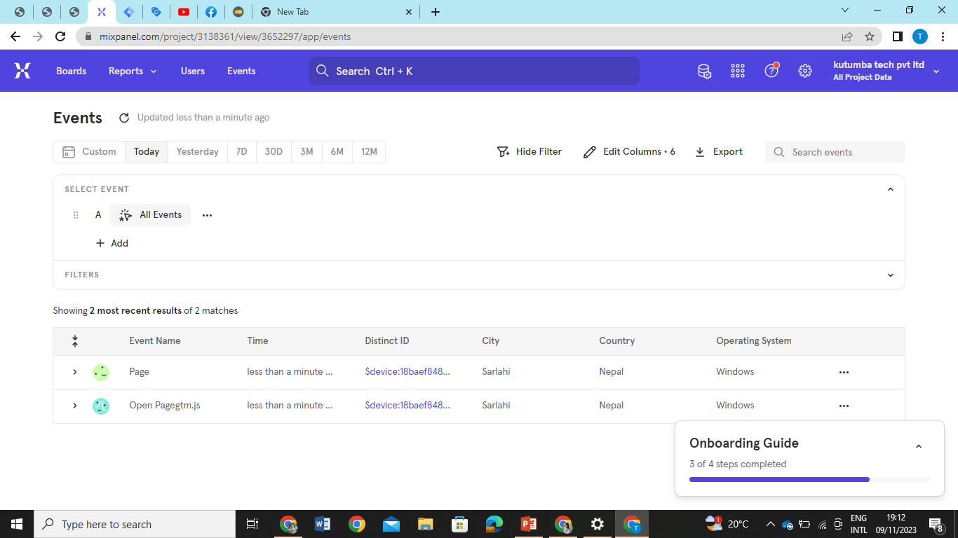

Slide 12
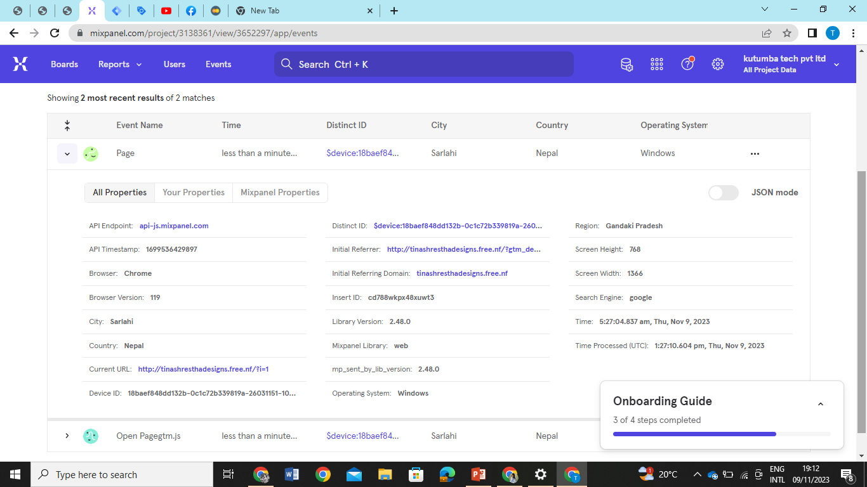

Slide 13


